Slide 1
T20 WORLD CUP ANALYSIS PROJECT

Slide 2
IMPORTING THE FILES:-
In this we will import all the necessary filles and directories which will be required to perform the operations over the database.
We will clean the data , perform feature engineering on the data ,applying visualization for better understating of the data then will build a model for further predictions.

Slide 3
DATA CLEANING:-
In this step from the present data that we have we will try to clean the data by removing any sort of duplication in the data, unknown data ,null data etc. so that our data becomes ready for further operation . Here we will also perform some operation's like encoding ,finding dimensionality of the data then finding any null values in the database then removing the data which is not useful for any further operations etc.

Slide 4
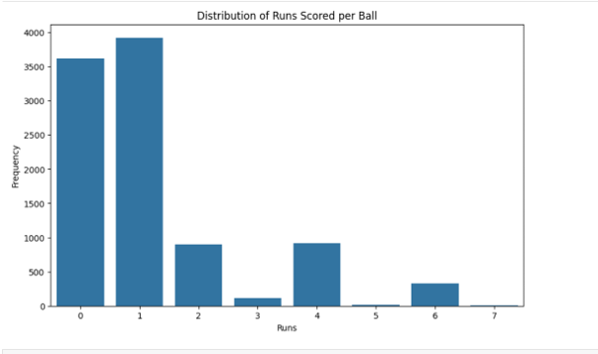
VISULAZATION :-
Here we will try to visualize the data to find the most runs scored with 4’s and 6’s.

Slide 5
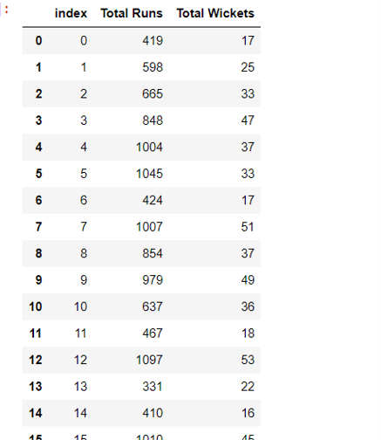
INSIGHTS:-
From the data we got to know that the most runs are scored by Indian Cricket Team while most wicket Taken by a team is Sri Lanka Cricket Team

Slide 6




The player with the most runs (Player 4) also has the most fours (78).
The player with the most wickets (Player 1) also has the most maidens (10).
The player with the most sixes (25) is not in the top 5 players by runs scored.
The player with the most wickets by spin bowling (15) is not in the top 5 players by wickets taken.

Slide 7
THANK YOU !

